Slide 1
Data Science RoadMap
Masoud Mazloom
20-07-2022

Slide 2
Data is the currency of the digital economy
Get the analytical skills you need to cash in
Although data is the lifeblood of the digital economy, many companies are blind to the value of the data they create. It’s time for that to change.

Slide 3
Interdisciplinary field that focuses on analyzing massive amounts of data to automatically identify inherent patterns, extract underlying models, and make relevant predictions.
Impacting virtually all areas of the economy, including science, engineering, medicine, banking, finance, sports and the arts.
Exciting real-world applications include credit card fraud detection, speech recognition, predictive medical diagnosis, and self-driving cars.

Slide 4
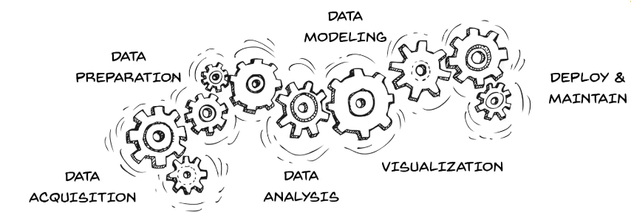
We will tell you how does it really work under the hood!

Slide 5
What is the data science learning roadmap?
Charts out multi-level skills map with details on
What skills you want to hone,
How you will measure the outcome at each level
and techniques to further master each skill

Slide 7
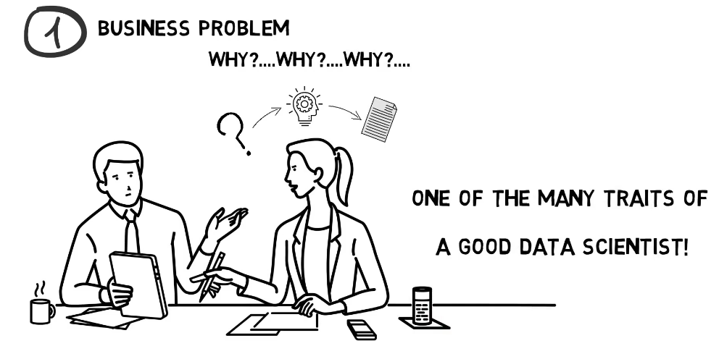

Slide 8
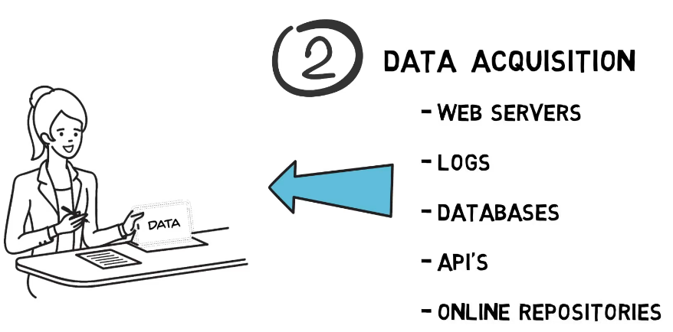

Slide 9
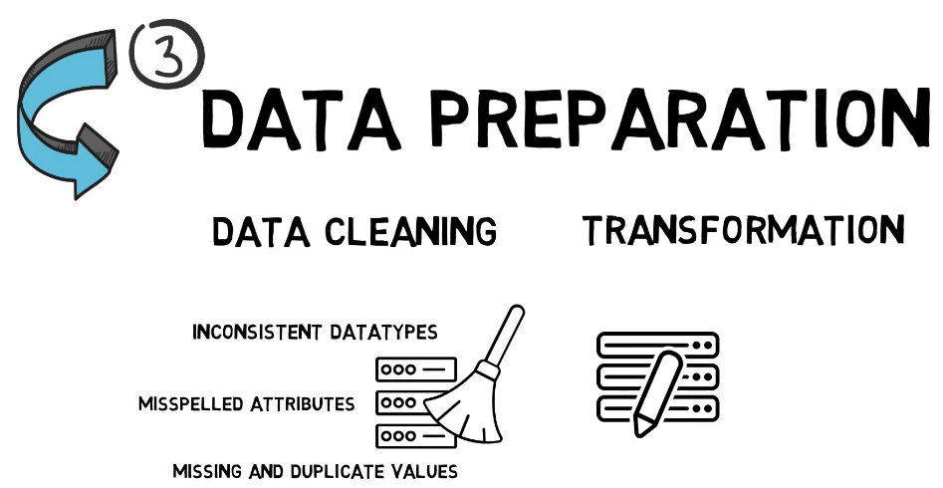

Slide 10
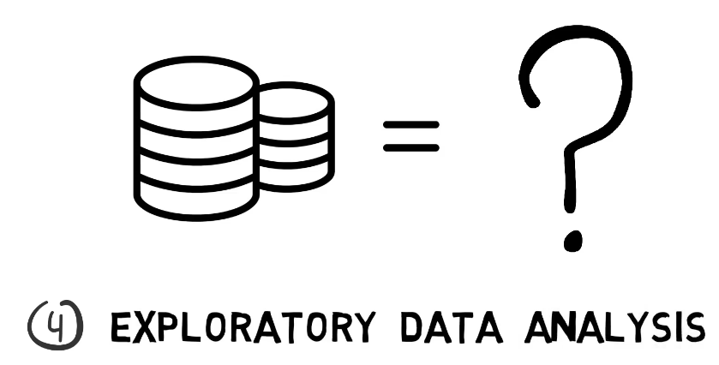

Slide 12
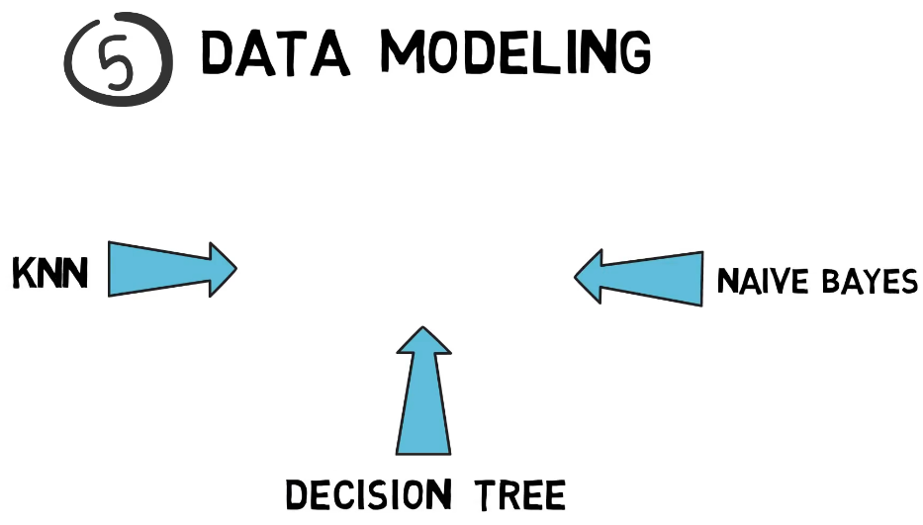

Slide 15
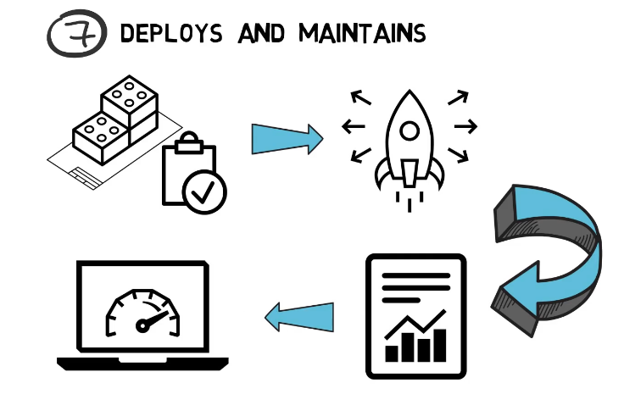

Slide 16
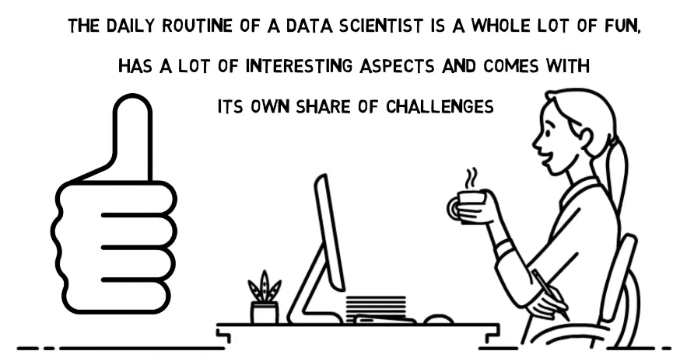

Slide 18
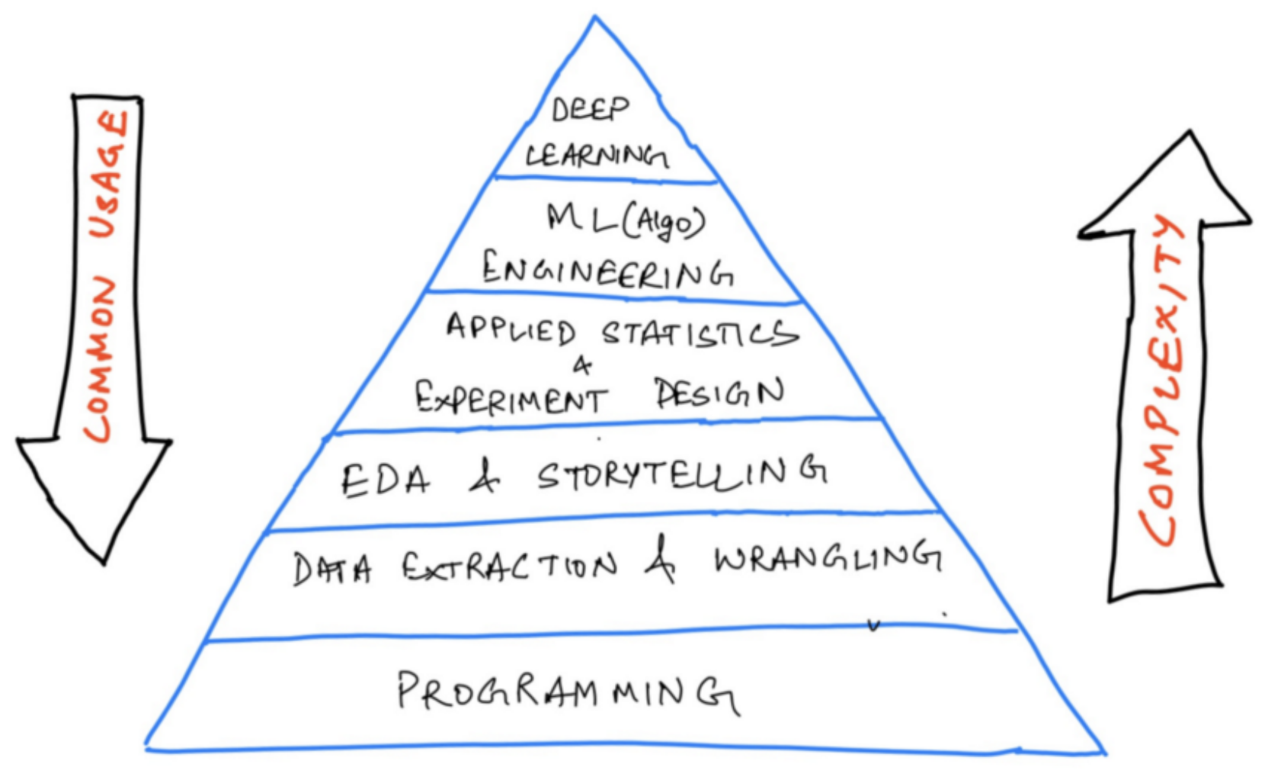
Complexity and common usage
Weights to each level based on the complexity and commonality of application in the real-world

Slide 19
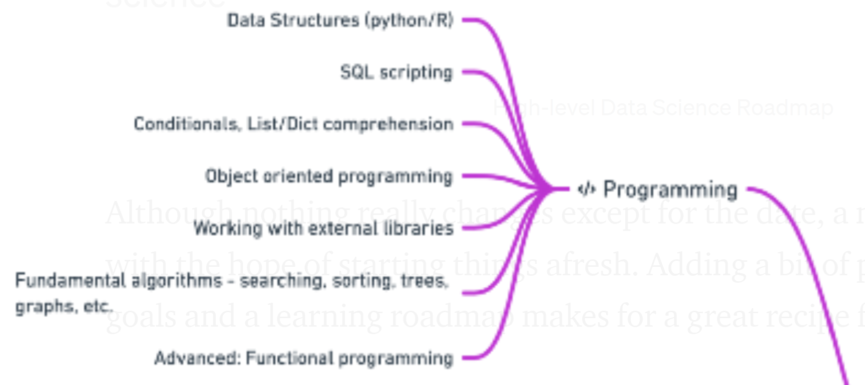
Programming or software engineering
Every data science job description would ask for programming expertise in at least one of the languages (Python/R)
Common data structures(data types, lists, dictionaries, sets, tuples), writing functions, logic, control flow, searching and sorting algorithms, object-oriented programming, and working with external libraries
SQL scripting: Querying databases using joins, aggregations, and subqueries
Comfortable with using the Terminal, version control in Git, and using GitHub
Resources for python:
learnpython.org
Kaggle
freecodecamp on YouTube
SQL:
Intro to SQL and Advanced SQL on Kaggle
Datacamp also offers many courses on SQL
Git:
Guide for Git and GitHub
Notes:
4-6 months

Slide 20
Data collection, extraction and wrangling
A significant part of the data science work is centered around finding apt data that can help you solve your problem
You can collect data from different legitimate sources:
scraping(if the website allows)
APIs
Databases
Publicly available repositories
Data is rarely clean and formatted for use in the “real world”. Pandas and NumPy are the two libraries that are at your disposal to go from dirty data to ready-to-analyze data.
Resources:
Data Manipulation using pandas
Data Cleaning course by Kaggle
freecodecamp course on learning Numpy, pandas
Notes:
3-4 months

Slide 21
Exploratory Data Analysis
Drawing insights from data and communicating to the management in simple terms
Exploratory data analysis:
Defining questions, handling missing values, outliers, formatting, filtering, univariate and multivariate analysis
Data visualization:
Plotting data using libraries like matplotlib
Knowledge to choose the right chart to communicate the findings from the data
Developing dashboards:
Use Excel or a specialized tool like Power BI and Tableau to build dashboards that summarize/aggregate data to help the management in making decisions
Business acumen:
Work on asking the right questions to answer, ones that actually target the business metrics
Practice writing clear and concise reports, blogs, and presentations
Resources:
Career track on Data Analysis
Data Analysis with Python
Data Visualization in Spreadsheets, Excel, Tableau, Power BI
Notes:
4-5 months

Slide 22
Statistics and Mathematics
Statistical methods are a central part of data science
Focus more on descriptive and inferential statistics
Descriptive Statistics: to be able to summarise the data is powerful but not always. Learn about estimates of location(mean, median, mode, weighted statistics, trimmed statistics), and variability to describe the data.
Inferential statistics: designing hypothesis tests, A/B tests, defining business metrics, analyzing the collected data and experiment results using confidence interval, p-value, and alpha values.
Linear Algebra, Single and multi-variate calculus to understand loss functions, gradient, and optimizers in machine learning.
Resources:
[Book]Practical statistics for data science(highly recommend)
Statistical thinking in Python
Intro to Descriptive Statistics
Inferential Statistics
Probability and Statistics for Data Science (Series) on Medium
Three Blue One Brown Lecture Series
Notes:
Responsibilities of a data engineer comprise building an efficient data architecture, streamlining data processing, and maintaining large-scale data systems.
to create ETL pipelines, automate file system tasks, and optimize the database operations to make it high-performance.
4-5 months

Slide 23
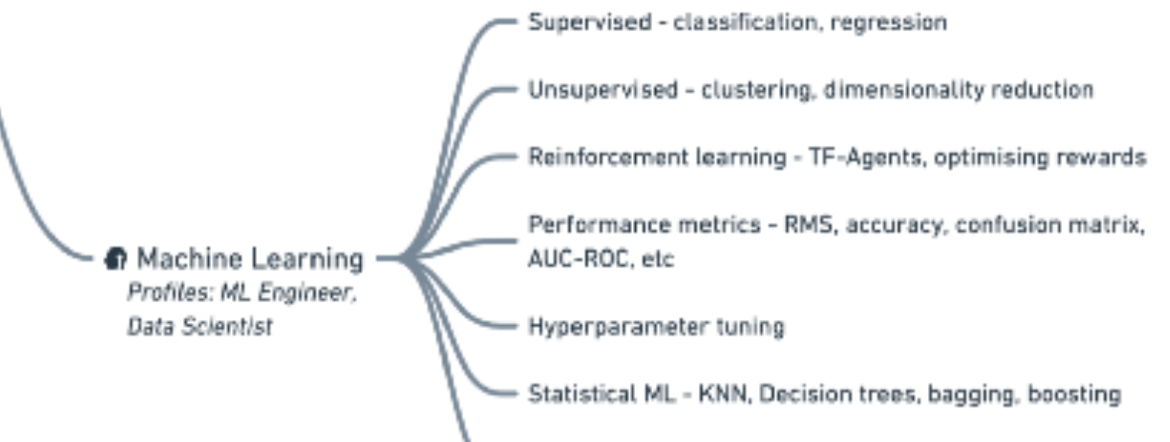
Machine learning
There are three major types of learning:
Supervised Learning — includes regression and classification problems. Study simple linear regression, multiple regression, polynomial regression, naive Bayes, logistic regression, KNNs, tree models, ensemble models. Learn about evaluation metrics.
Unsupervised Learning — Clustering and dimensionality reduction are the two widely used applications of unsupervised learning. Dive deep into PCA, K-means clustering, hierarchical clustering, and gaussian mixtures.
Reinforcement learning(can skip*) — helps you build self-rewarding systems. Learn to optimize rewards, using the TF-Agents library, creating Deep Q-networks, etc.
Resources:
[book]Hands-On Machine Learning with Scikit-Learn, Keras, and TensorFlow, 2nd Edition
[book]Pattern recognition and Machine Learning
Machine Learning Course by Andrew Ng
Introduction to Machine Learning
Supervised learning with Python
Notes:
5-6 months

Slide 26
Soft skills (people behavior skills)
Commonly used to “refer to the “emotional side” of human beings in opposition to the IQ
Character traits and interpersonal skills that characterize a person's relationships with others
Help employees interact with others and succeed in the workplace
Describe a person's emotional quotient (EQ) as opposed to intelligence quotient (IQ)
Soft skills include:
Communication skills
Mentor your coworkers
Leadership skills
Follow instructions, and get a job done on time
Team building and Teamworking skills
Problem-solving skills
Analytical skills
Collaboration
97% of employers say that soft skills are either as important or more important than hard skills
80% of companies' success is due to soft skills

Slide 27
Resources
https://towardsdatascience.com/data-science-learning-roadmap-for-2021-84f2ba09a44f
https://skaf.medium.com/data-scientist-roadmap-2022-3e247fe6fe87
https://www.mltut.com/data-science-with-python-roadmap/
https://towardsdatascience.com/become-a-data-scientist-in-2022-a-practical-52-week-course-8244cc18284e
https://omdena.com/blog/data-science-road-map/

